Slide 1


A Data-Driven Historical Analysis Nora May March 28, 2019 Metis Career Day
Notes:
Hi, I’m Nora May. For my project, I applied data science processing techniques on Cosmopolitan Magazine covers since the 1950s to analyze changes in writing about and marketing to women.

Slide 2
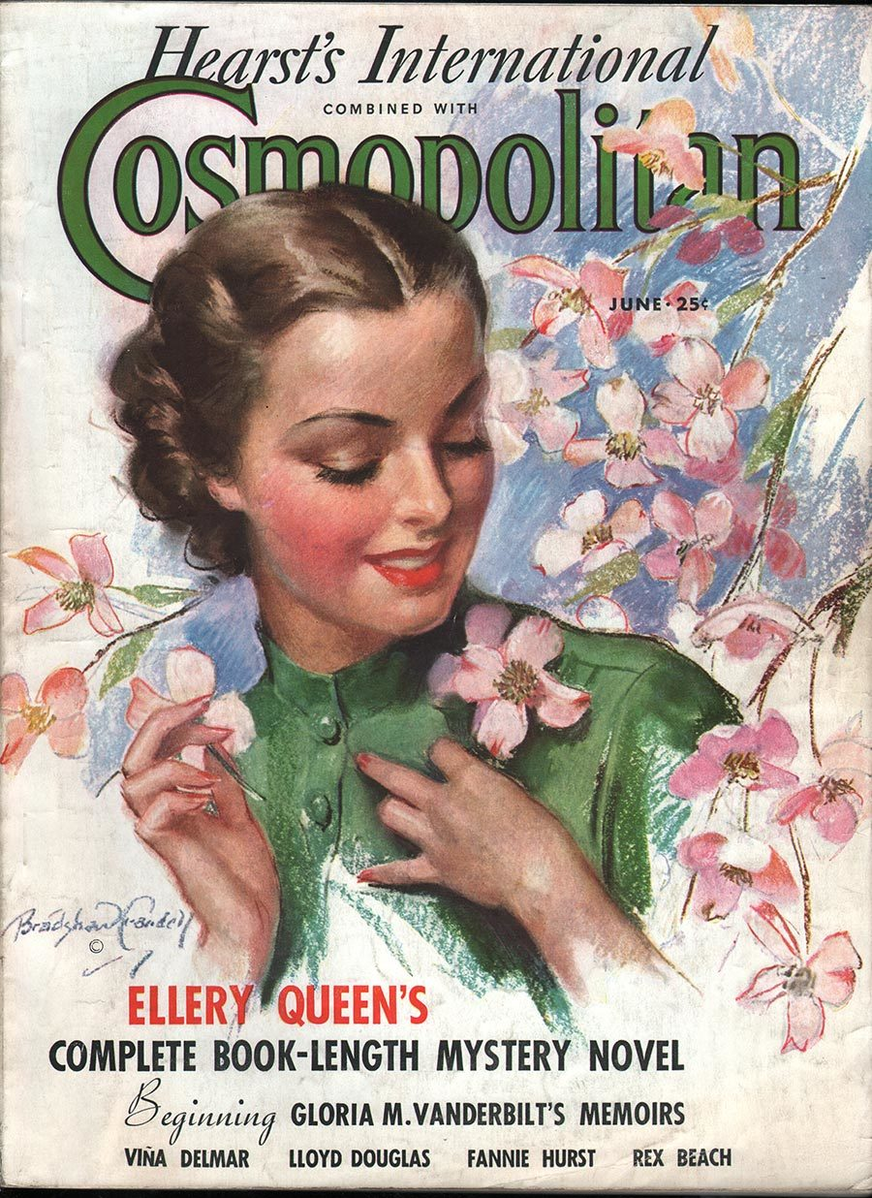
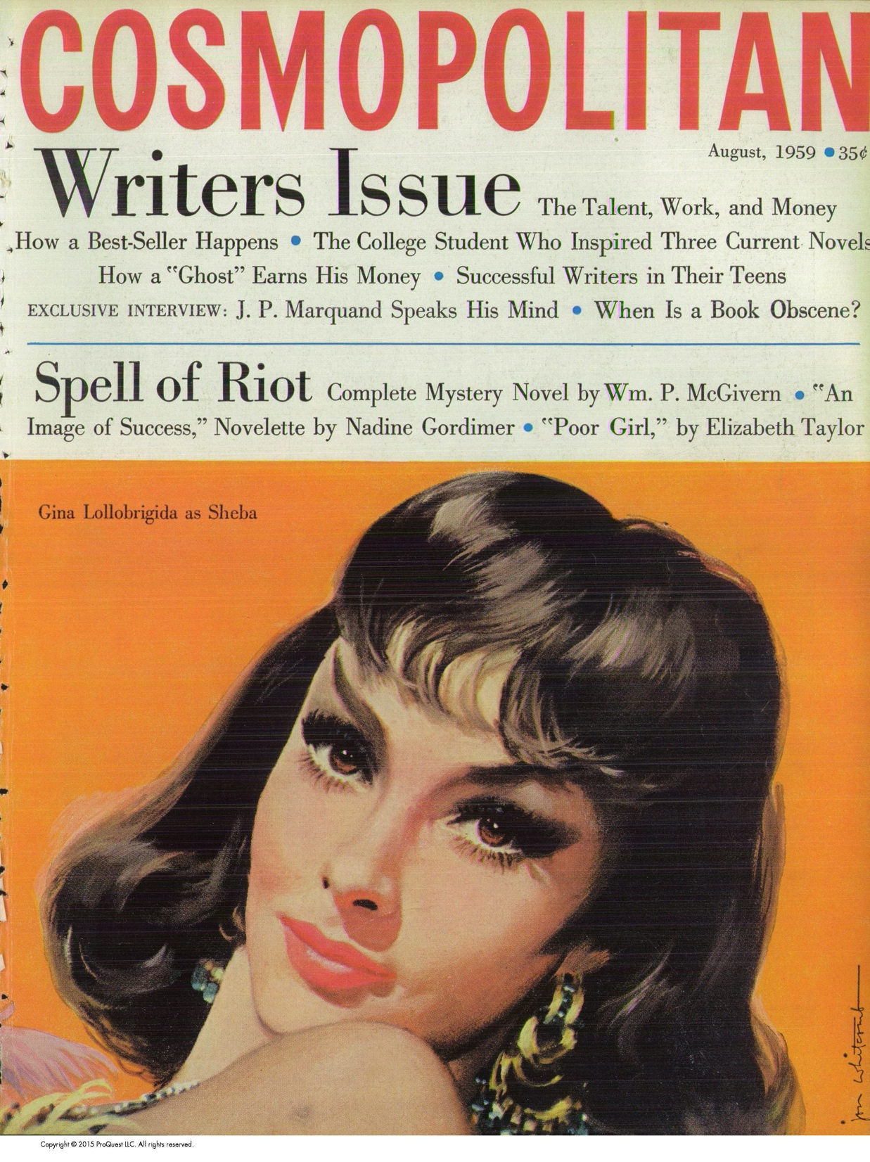
1936
1959
Notes:
I wanted to analyze how their intention to appeal to women migrated from this:

Slide 3
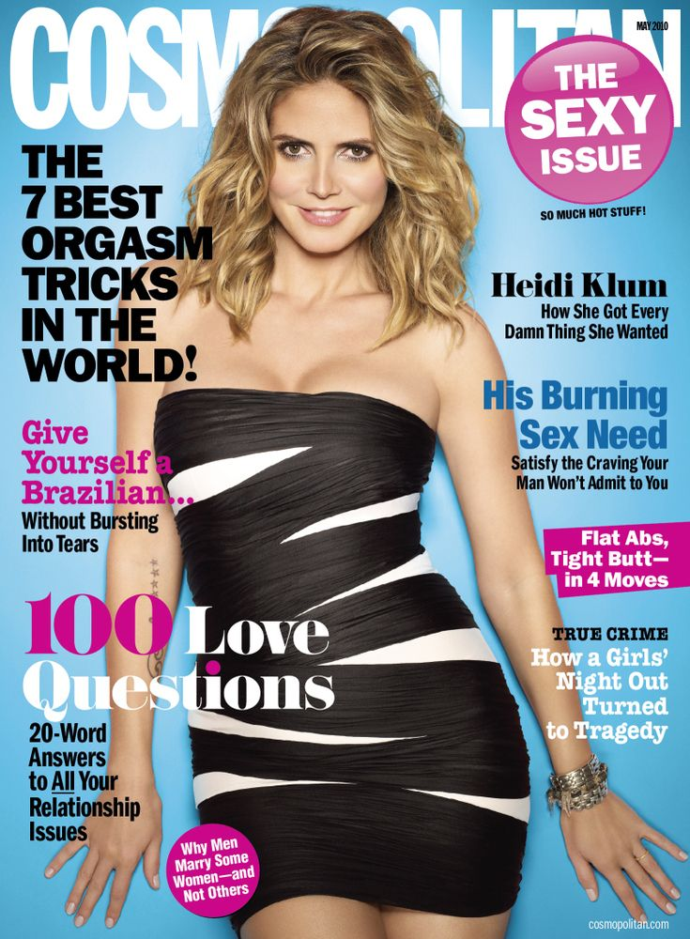
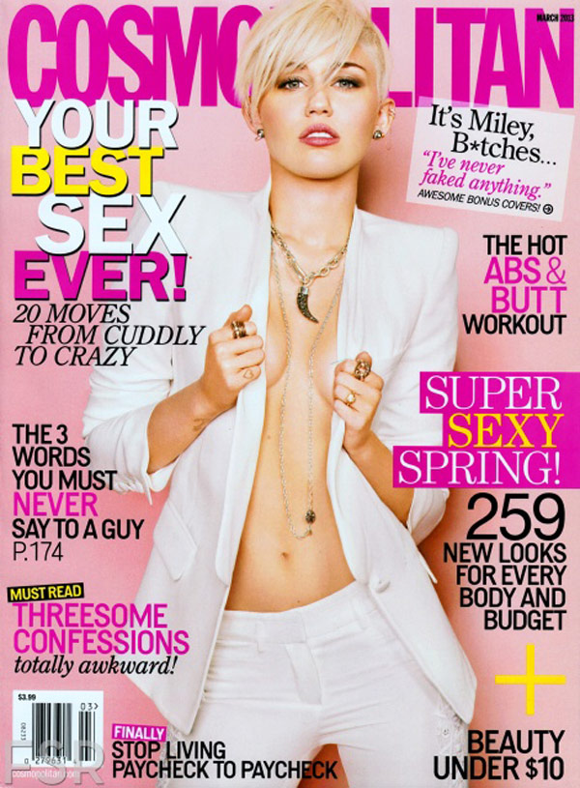
2010
2013
Notes:
To this

Slide 4
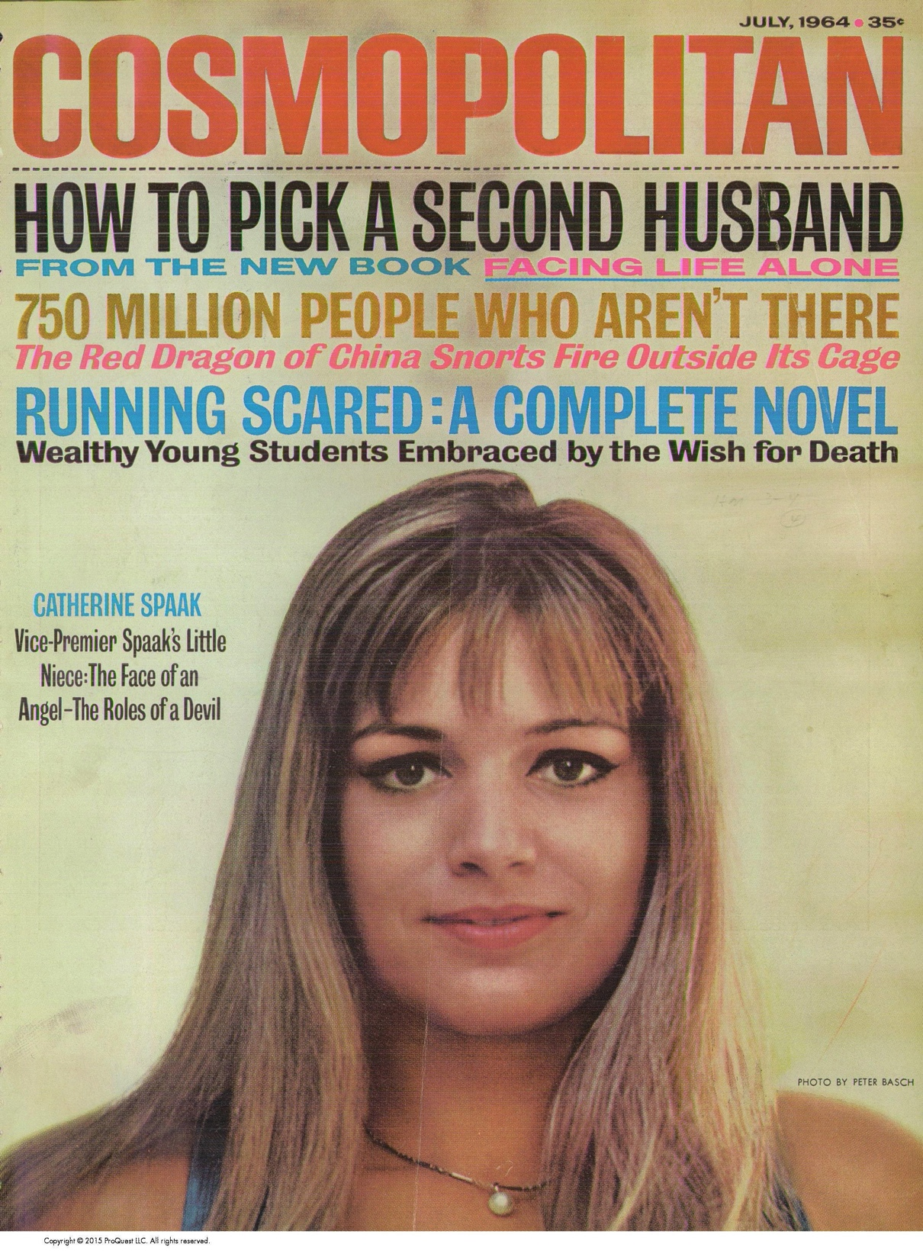
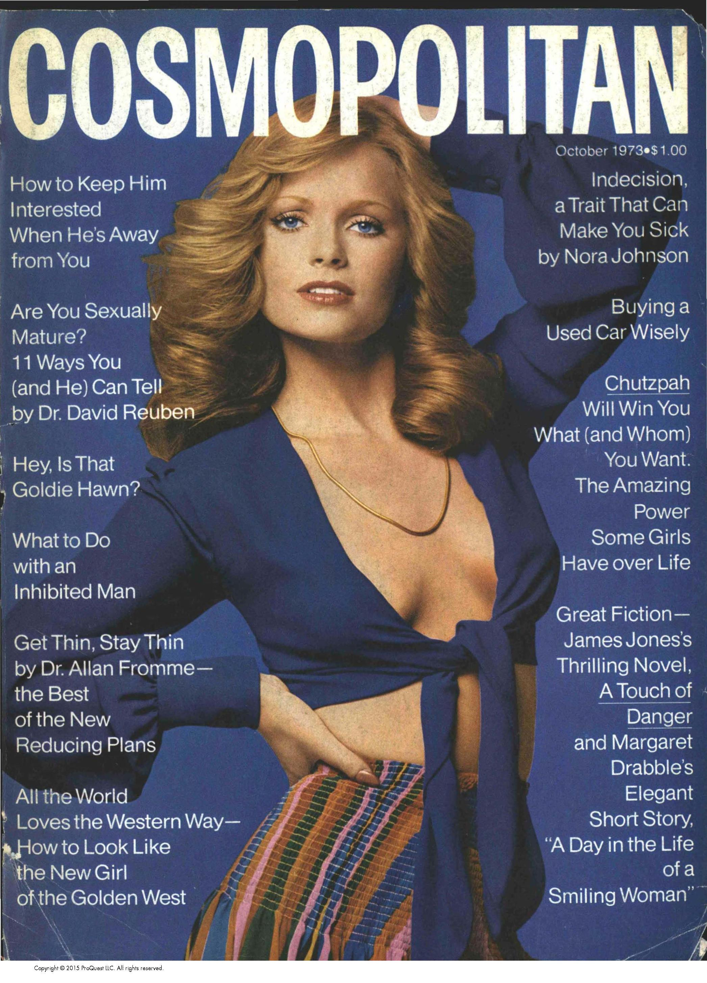
Data and Process
Cosmopolitan Magazine Covers (1950-2018)
Analyzing Topics:
Optical Character Recognition (OCR)
NLP Topic Modeling
Analyzing Visual Trends:
Average Pixels
Notes:
I incorporated both written and visual data from the covers into my analysis. I used optical character recognition and natural language processing to understand text and made composite images using the average pixels over time periods to look at the visual design changes.

Slide 5
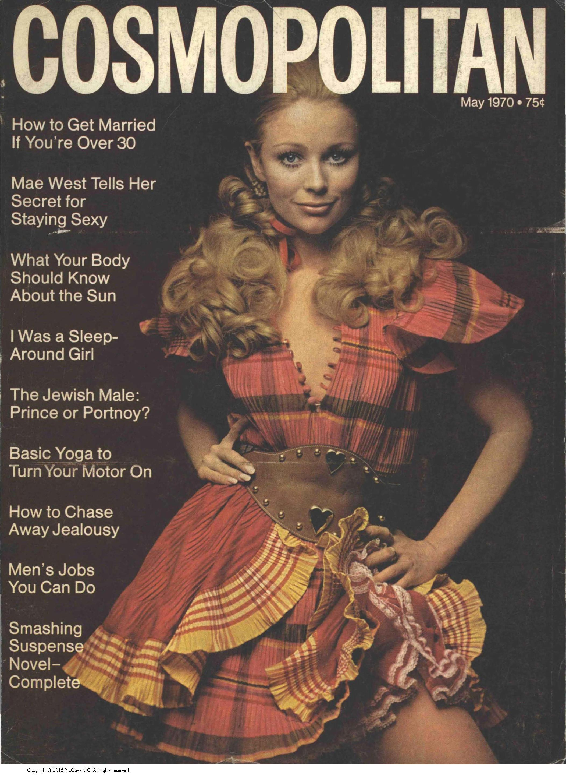
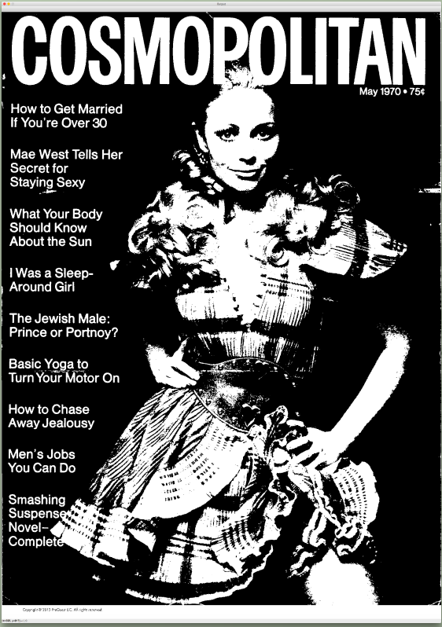
Optical character recognition (ocr)
Read words on PDF
Text recognition using OpenCV and Google’s Tesseract-OCR Engine
Notes:
My first task was to extract the text from the covers in my data set to do NLP. To accomplish this goal, I used Google's Tesseract OCR engine, trained to recognize and extract text in an image. The default image preprocessing worked well on the earlier covers like this,

Slide 6
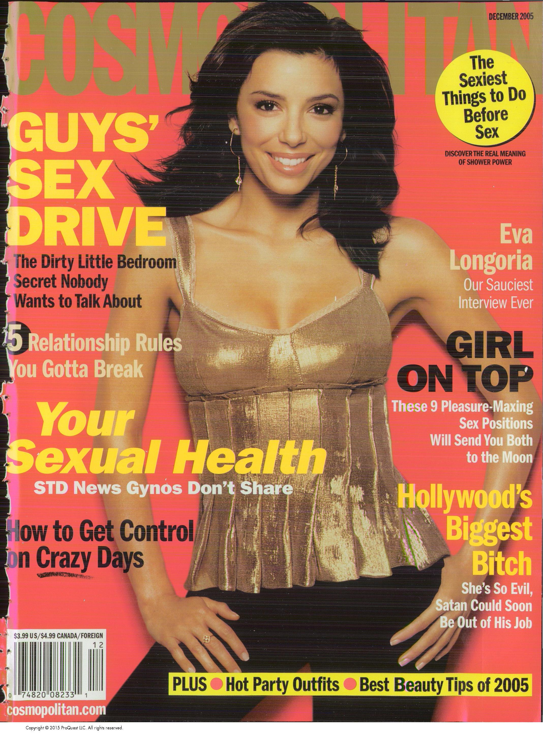
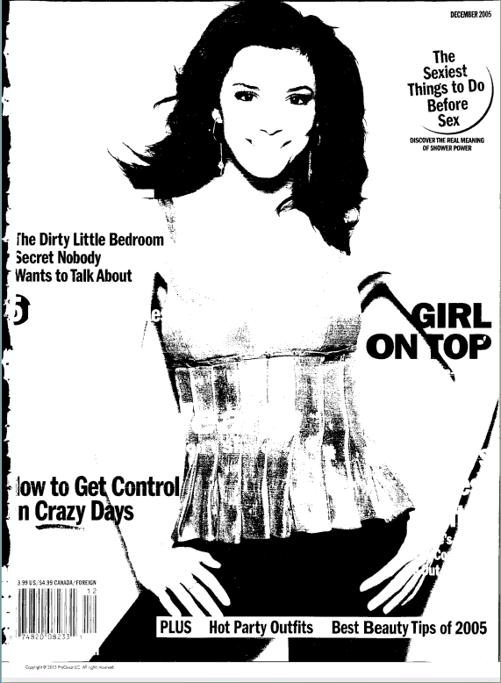
Optical character recognition (ocr)
Read words on PDF
Text recognition using OpenCV and Google’s Tesseract-OCR Engine
Notes:
However, Later covers with more sophisticated graphics meant tesseract’s default preprocessing lost more than half the text.

Slide 7
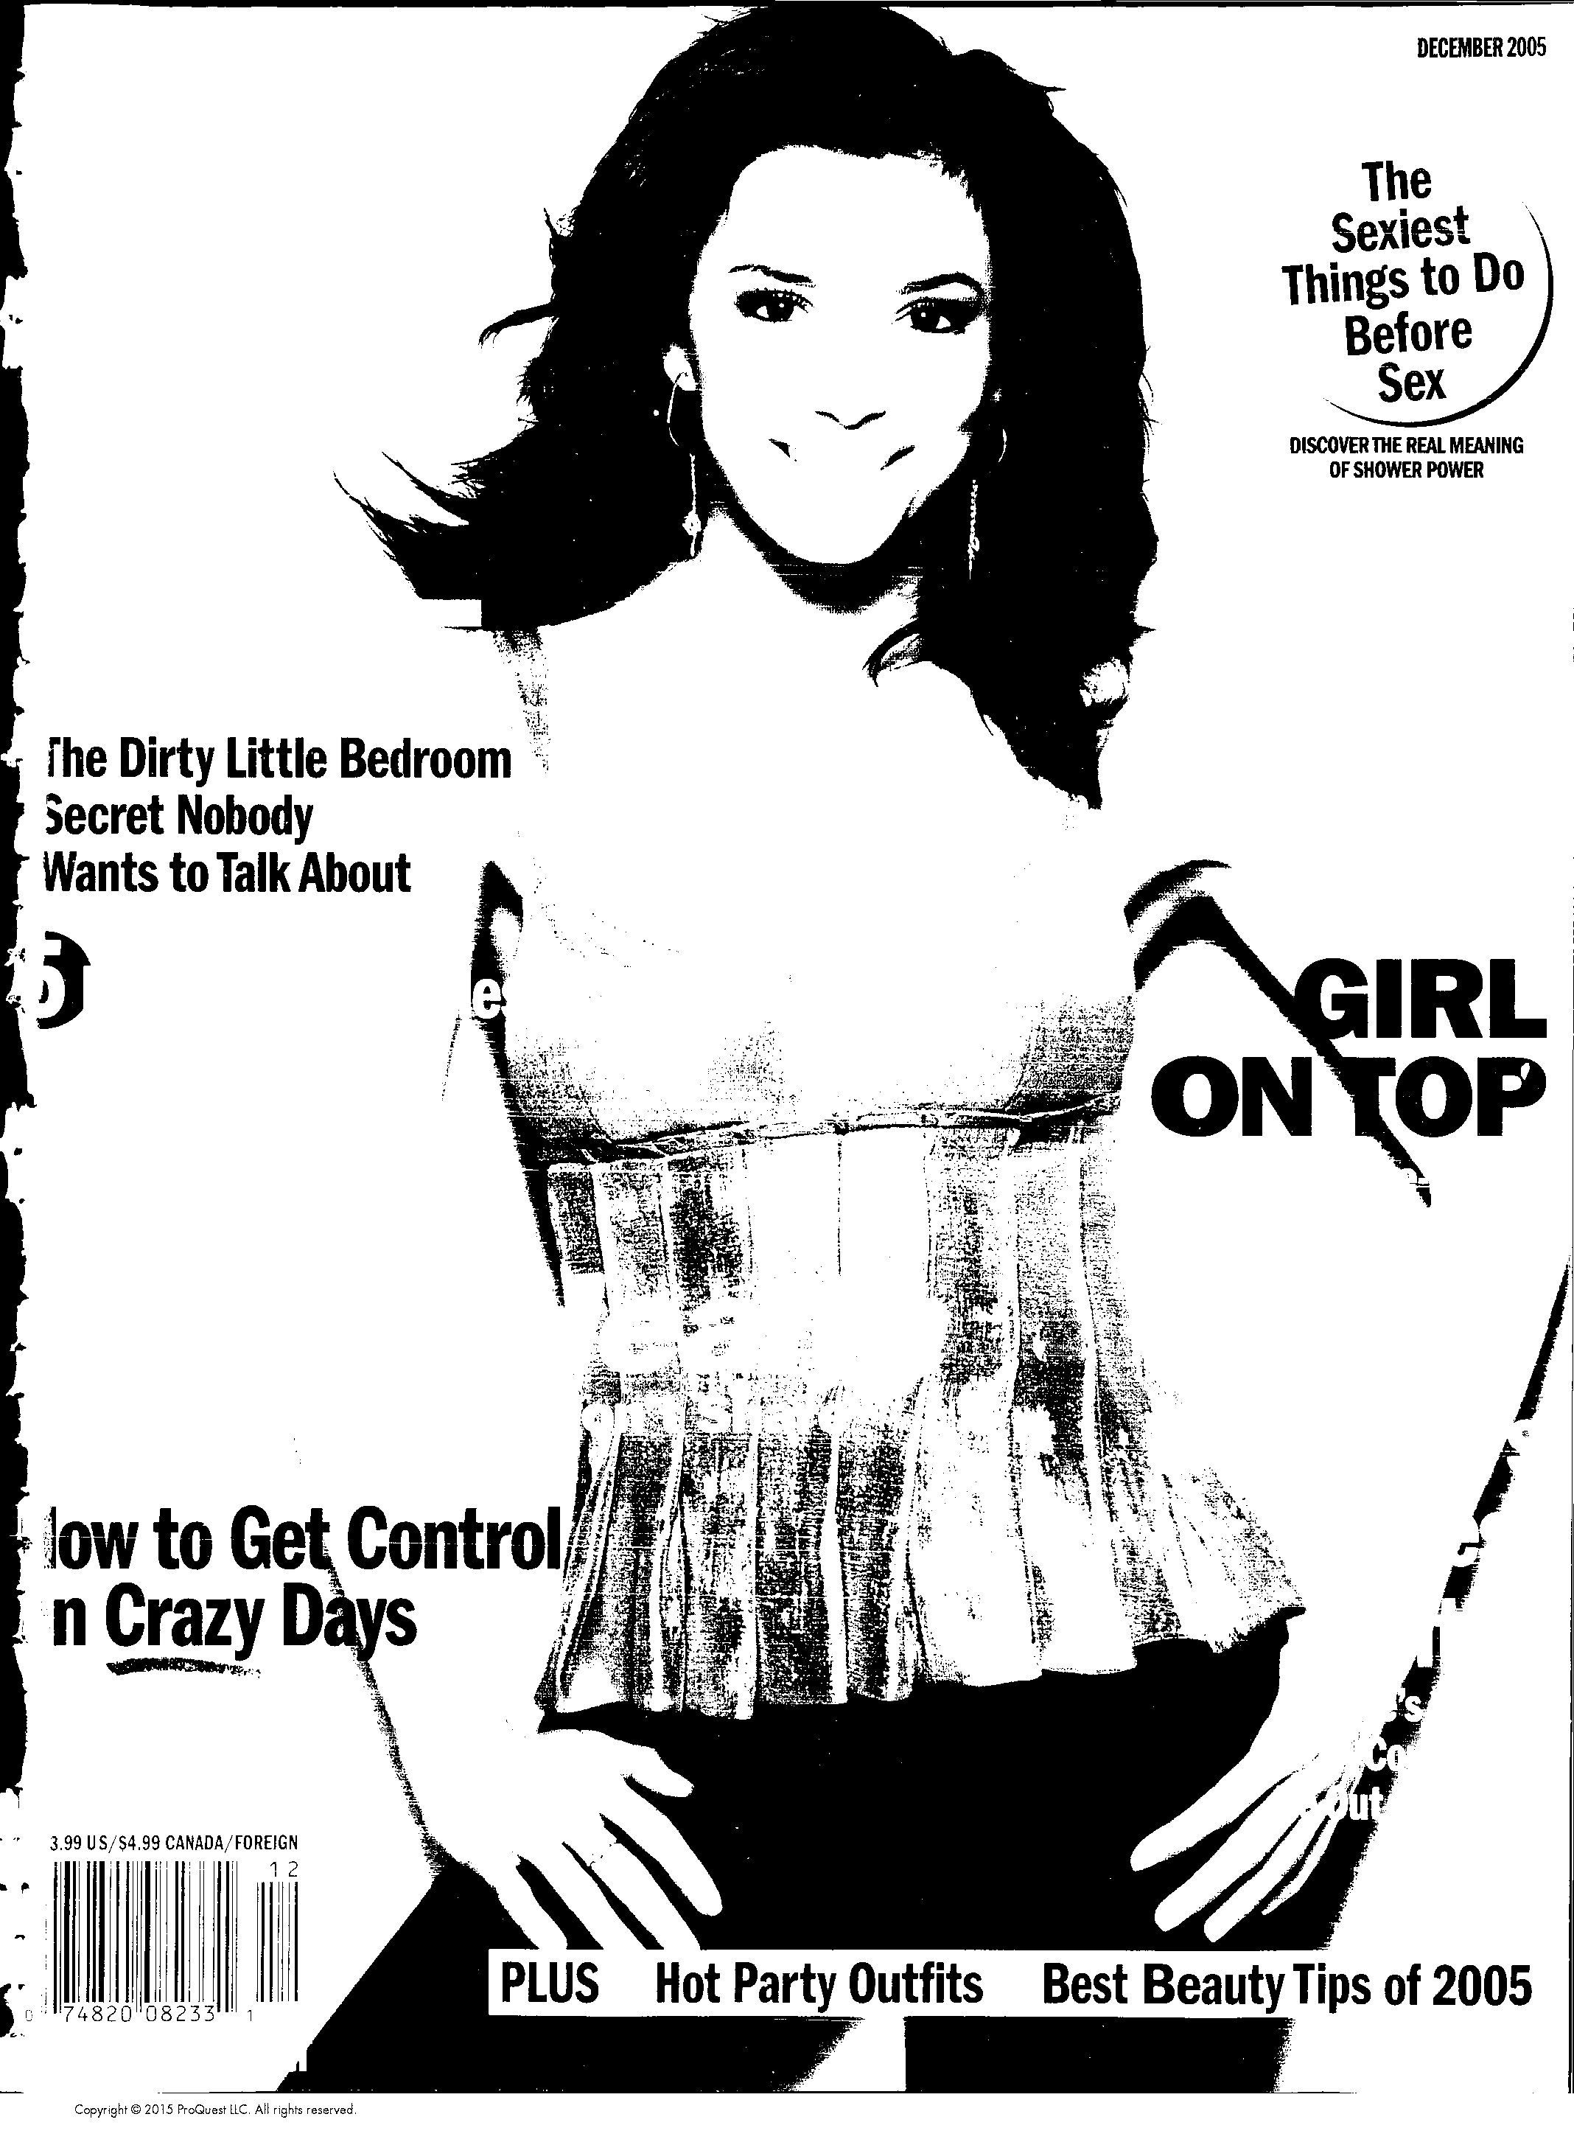
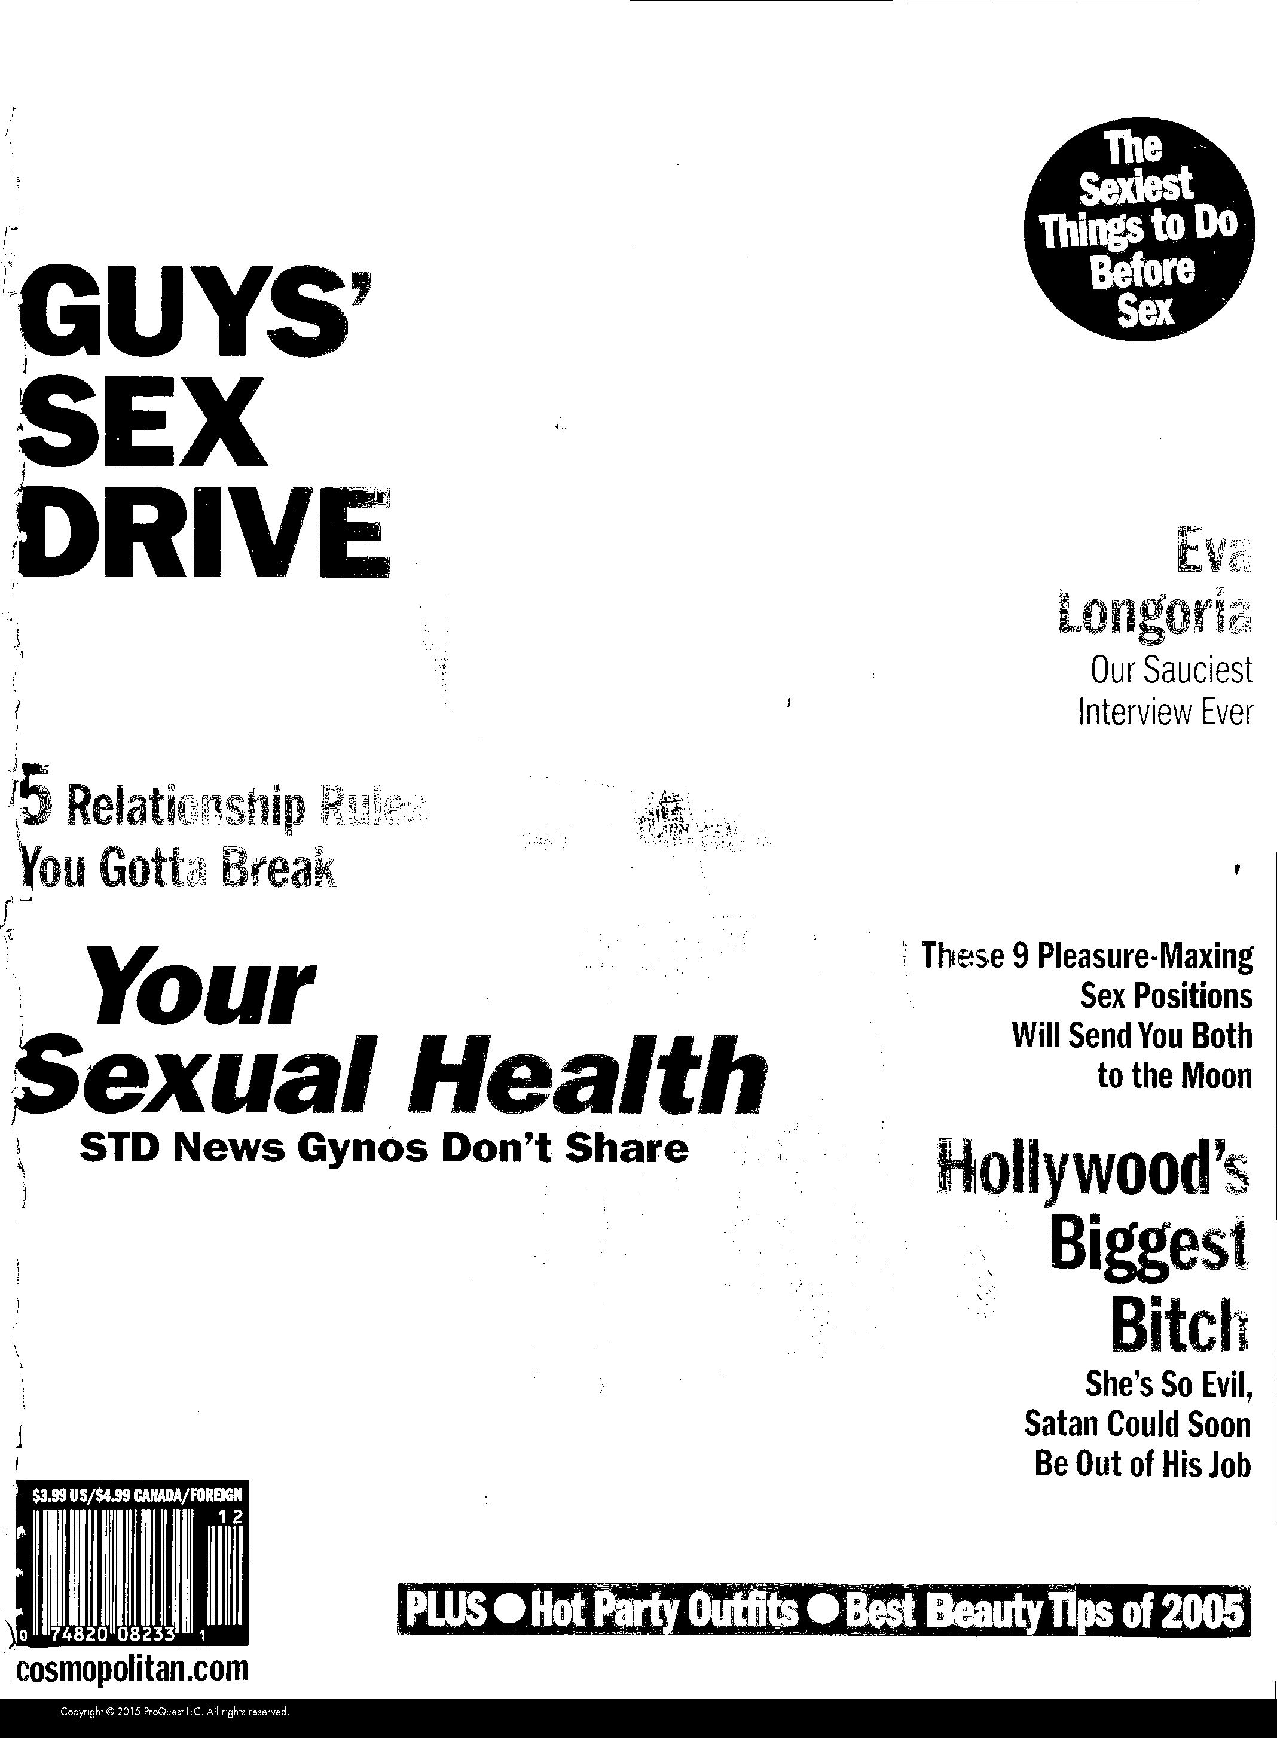
Optical character recognition (ocr)
Tesseract
Vary binary threshold on image and inverse of image
50-90% of words recorded
Default Binarization
Binarization of inverse
Notes:
To solve this, I inverted the images and changed the black and white dividing threshold to be between the background color and the lighter text colors, and was able to record a much larger percentage of the text.

Slide 8
NLP: Topic Modeling Count Vectorizer and NMF: 1950-2018
Mysteries: complete mystery murder husband see stories girls short money summer suspense children special
Fiction: best girl plus short stories girls story fiction life seller book diet two lover woman
Sex: make ways life sexy ever good bed hot know tricks things secret guys never feel
Resolutions: astrologer bedside money career guide cosmos health bonus star year plus beauty travel advice family
Relationships/Life: life super way rich much affair know want quiz long relationship young
Miscellaneous: first excerpt big girl together lovers making stunning turn marriage sexual girls romance
Notes:
With this text, I was able to perform natural language processing. Using NMF to do topic modeling, I saw these 6 topics over time. Based on my perception of Cosmo during my lifetime,

Slide 9
NLP: Topic Modeling Count Vectorizer and NMF: 1950-2018
Mysteries: complete mystery murder husband see stories girls short money summer suspense children special
Fiction: best girl plus short stories girls story fiction life seller book diet two lover woman
Sex: make ways life sexy ever good bed hot know tricks things secret guys never feel
Resolutions: astrologer bedside money career guide cosmos health bonus star year plus beauty travel advice family
Relationships/Life: life super way rich much affair know want quiz long relationship young
Miscellaneous: first excerpt big girl together lovers making stunning turn marriage sexual girls romance
Notes:
I was surprised to see that two out of six of the identified categories were associated with literature

Slide 10
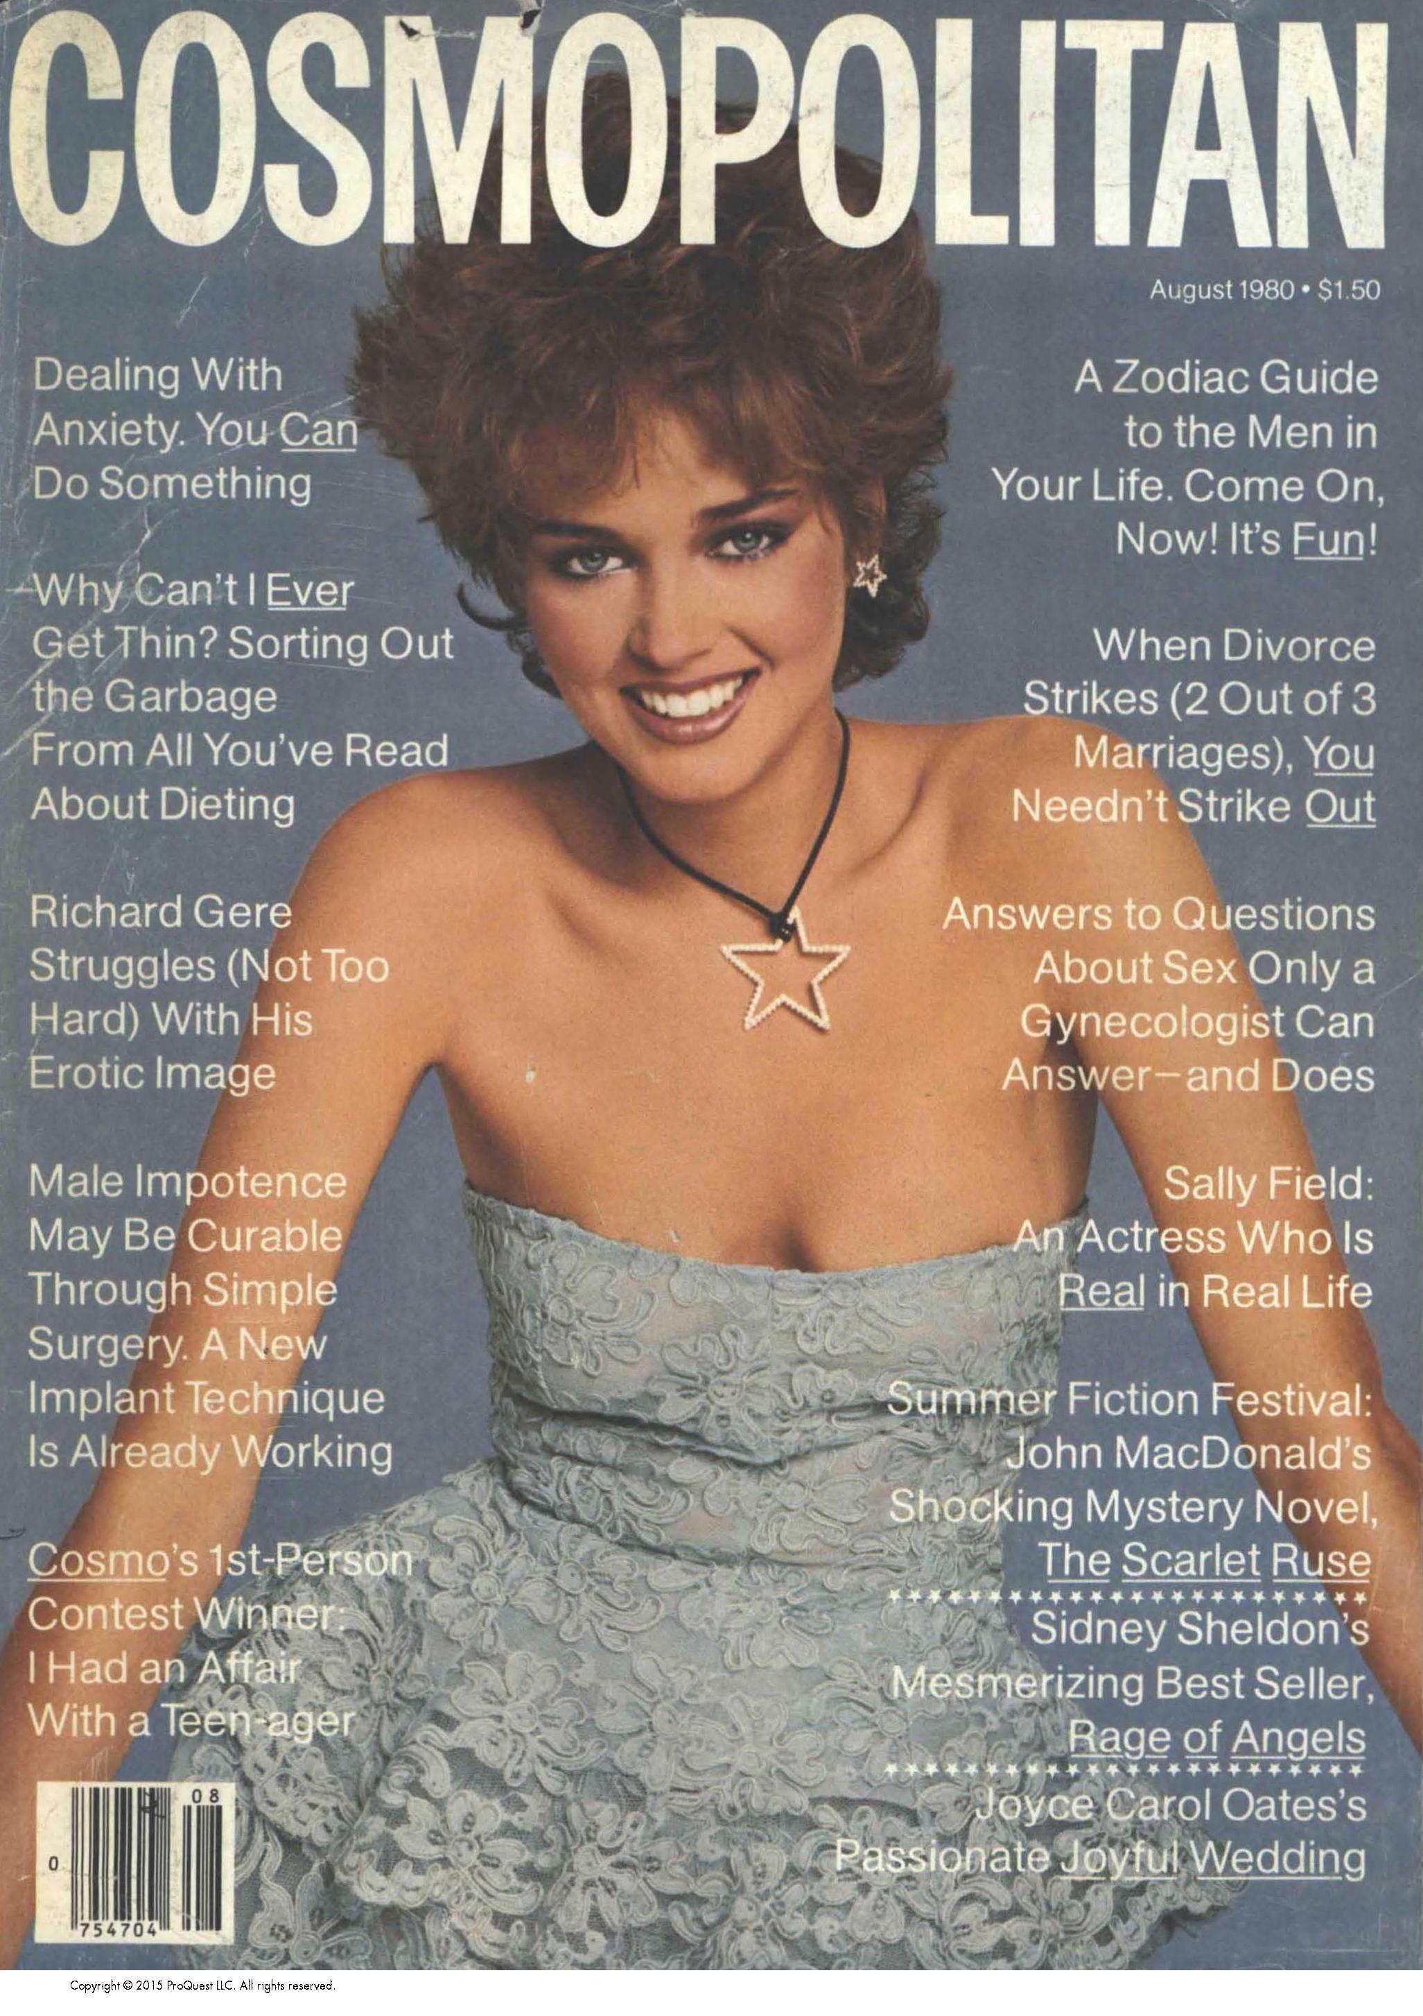
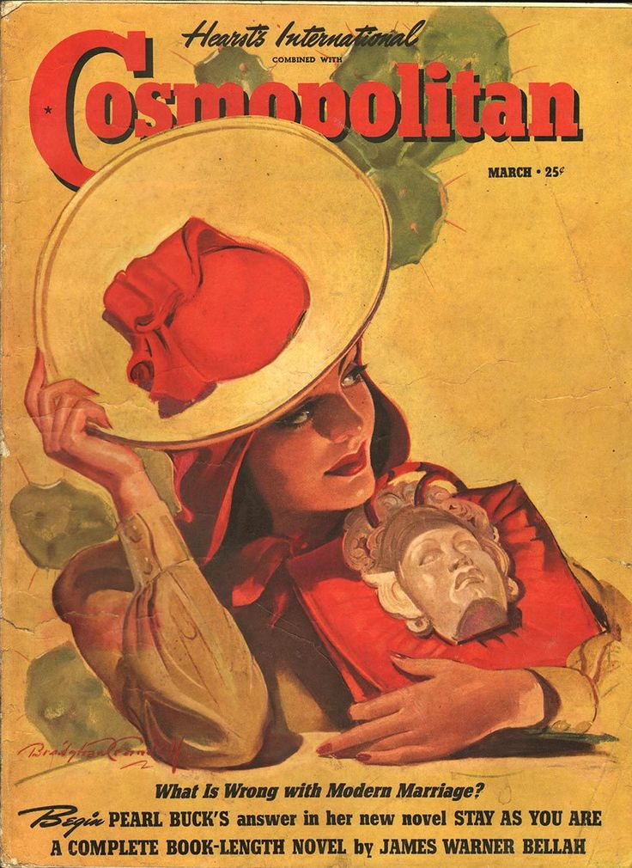
1940
1980
Notes:
but then I learned that the magazine serialized novels and short stories up into the 50s, and fiction continued to appear into the 90s:

Slide 11
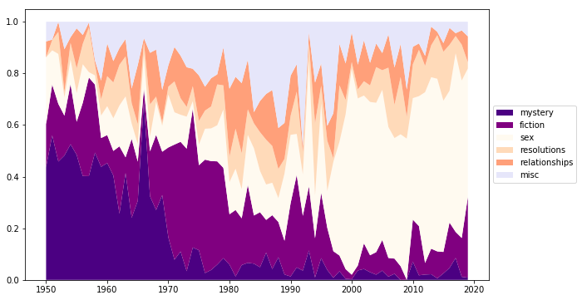
NLP: Topic Modeling
Count Vectorizer and NMF: 1950-2018
Notes:
This graph displays the percentage of cover text associated with each of the six identified topics averaged per year. As you can see, the percentage of content related to literature continuously declines during the time period I analyzed.

Slide 12
NLP: Topic Modeling
Count Vectorizer and NMF: 1950-2018
EIC Change
Notes:
The vertical lines here denote changes in editors. This visualizes that the distribution of topics change when editors change.
With the first female editor in 1965, the first dotted line, there is a decrease in the mystery topics, and in turn you get more about women’s individual lives and interests. When that editor’s 30 year tenure ended, the shift away from literary content continued more and to replace:

Slide 13
NLP: Topic Modeling
Count Vectorizer and NMF: 1950-2018
EIC Change
Notes:
we have a extremely high percentage of words in the “sex” topic.
It was my intuition that this was likely encompassing more than just sex, like beauty, health, and money, but on this broad view they were not being distinguished, so I tried to get a more granular view based on a subset of dates.

Slide 14
NLP: Topic Modeling Count Vectorizer and NMF: 1980-2018
Sex: hot bed sexy guys never things moves guy really naughty
Astrology: astrologer bedside cosmos health career guide astral bonus money star
Relationships: man woman girl husbands tantalizing makeup married friends woman secrets marriage
Cover Girl: money big me work hollywood quiz hot good sexy young
Secrets: bad know secrets surprising couples reveal boyfriend terrace readers believe
Miscellaneous: read things movie keep beautiful working fast bitchy husbands discover
Hints/How-to: guide interested girls know everything relationships christmas marriage survival
Power: best ahead getting scary power years sexy turning learn loving
Human Interest: happen know girl help even rape living sure perhaps stories someone
Health/Beauty: feel tricks secret take story diet stay skin sexier fearless tips beauty
Notes:
Narrowing to the period from 1980 to today, I did topic modeling and found these ten topics, many of which are more nuanced. like notably a “power” topic, with words like “power” , “learn”, and “getting ahead.”

Slide 15
NLP: Topic Modeling Count Vectorizer and NMF: 1980-2018
Sex: hot bed sexy guys never things moves guy really naughty
Astrology: astrologer bedside cosmos health career guide astral bonus money star
Relationships: man woman girl husbands tantalizing makeup married friends woman secrets marriage
Cover Girl: money big me work hollywood quiz hot good sexy young
Secrets: bad know secrets surprising couples reveal boyfriend terrace readers believe
Miscellaneous: read things movie keep beautiful working fast bitchy husbands discover
Hints/How-to: guide interested girls know everything relationships christmas marriage survival
Power: best ahead getting scary power years sexy turning learn loving
Human Interest: happen know girl help even rape living sure perhaps stories someone
Health/Beauty: feel tricks secret take story diet stay skin sexier fearless tips beauty
Notes:
If we zoom in on the topics of relationships and power,

Slide 16
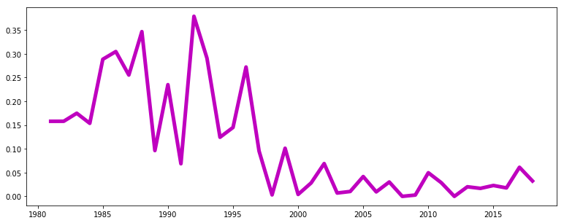
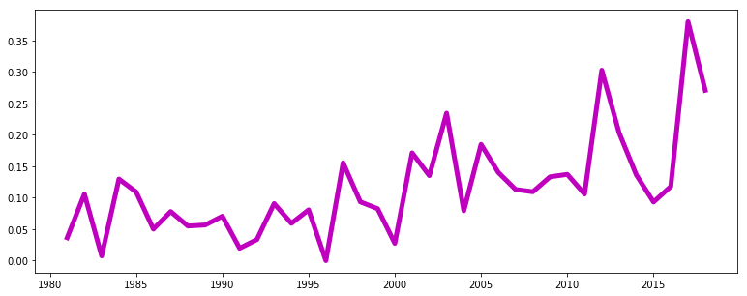
NLP: Topic Modeling
Count Vectorizer and NMF: 1980-2018
“Relationships”
EIC Change
“Power”
Notes:
We see that the 2000s show a decrease “Relationships,” topic reflecting a societal shift away from defining women via boyfriends and marriage. At the same time, we see an increase in the percentage of “power” words in the 2000s, indicating an editorial shift toward empowerment, away from condescending topics like “how-to guides.”

Slide 17

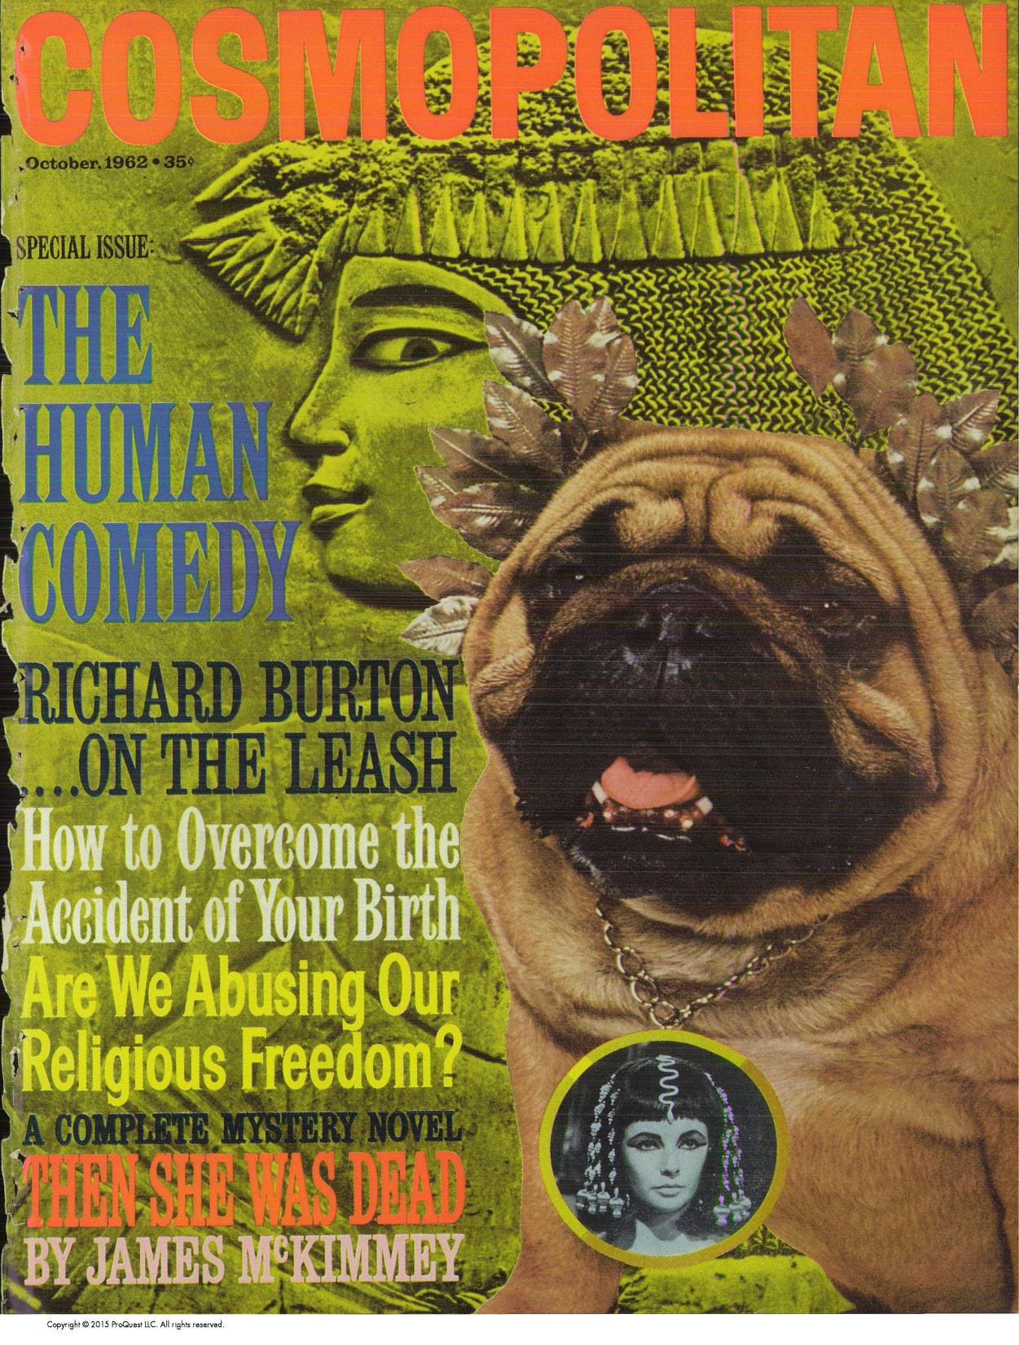
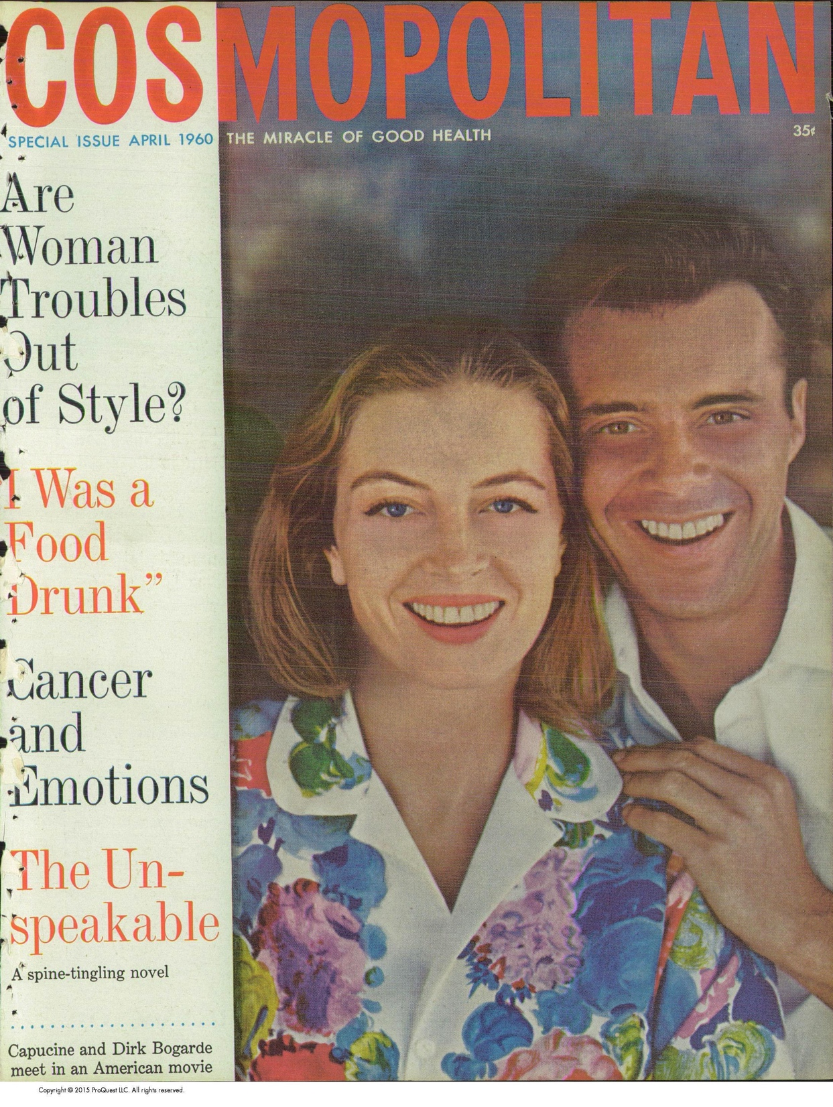
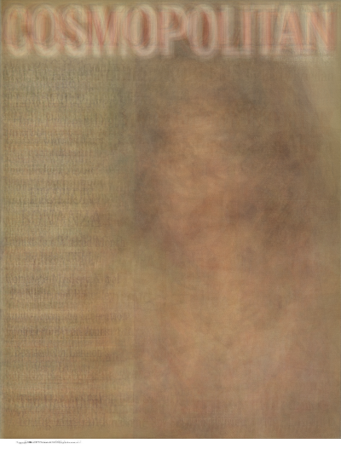
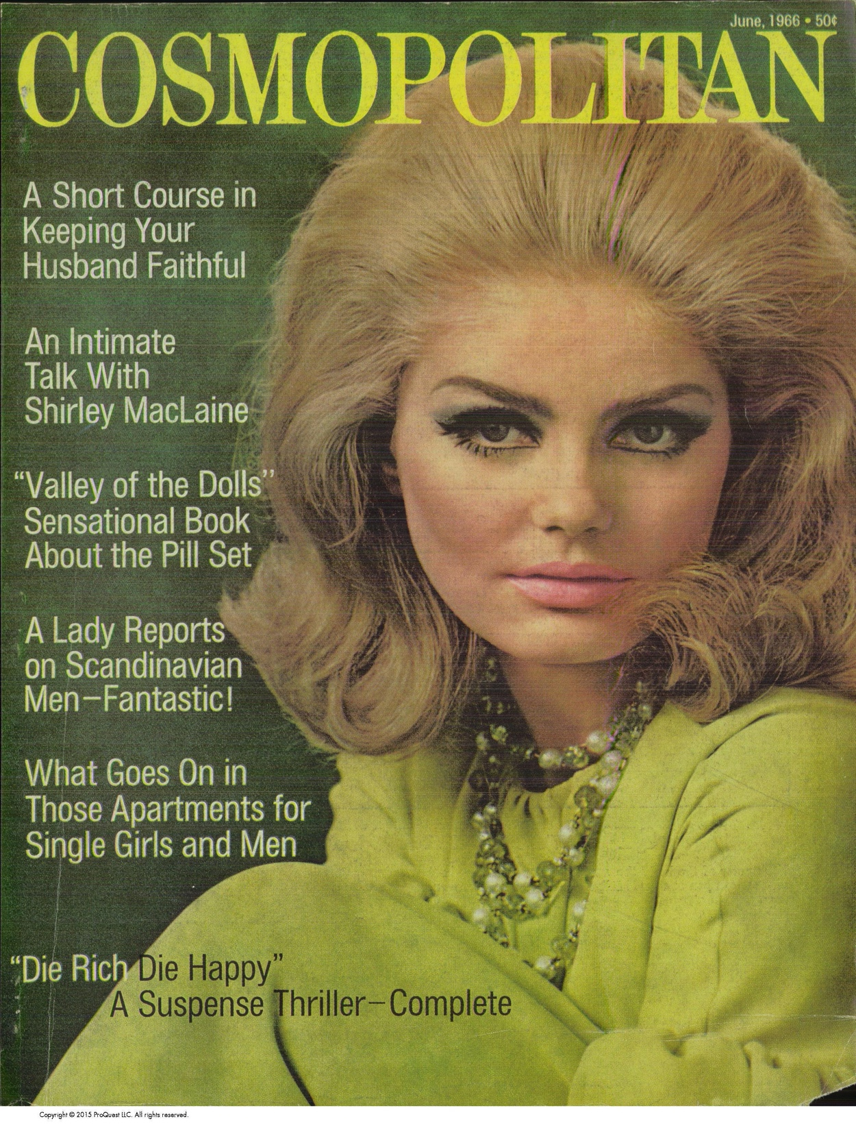
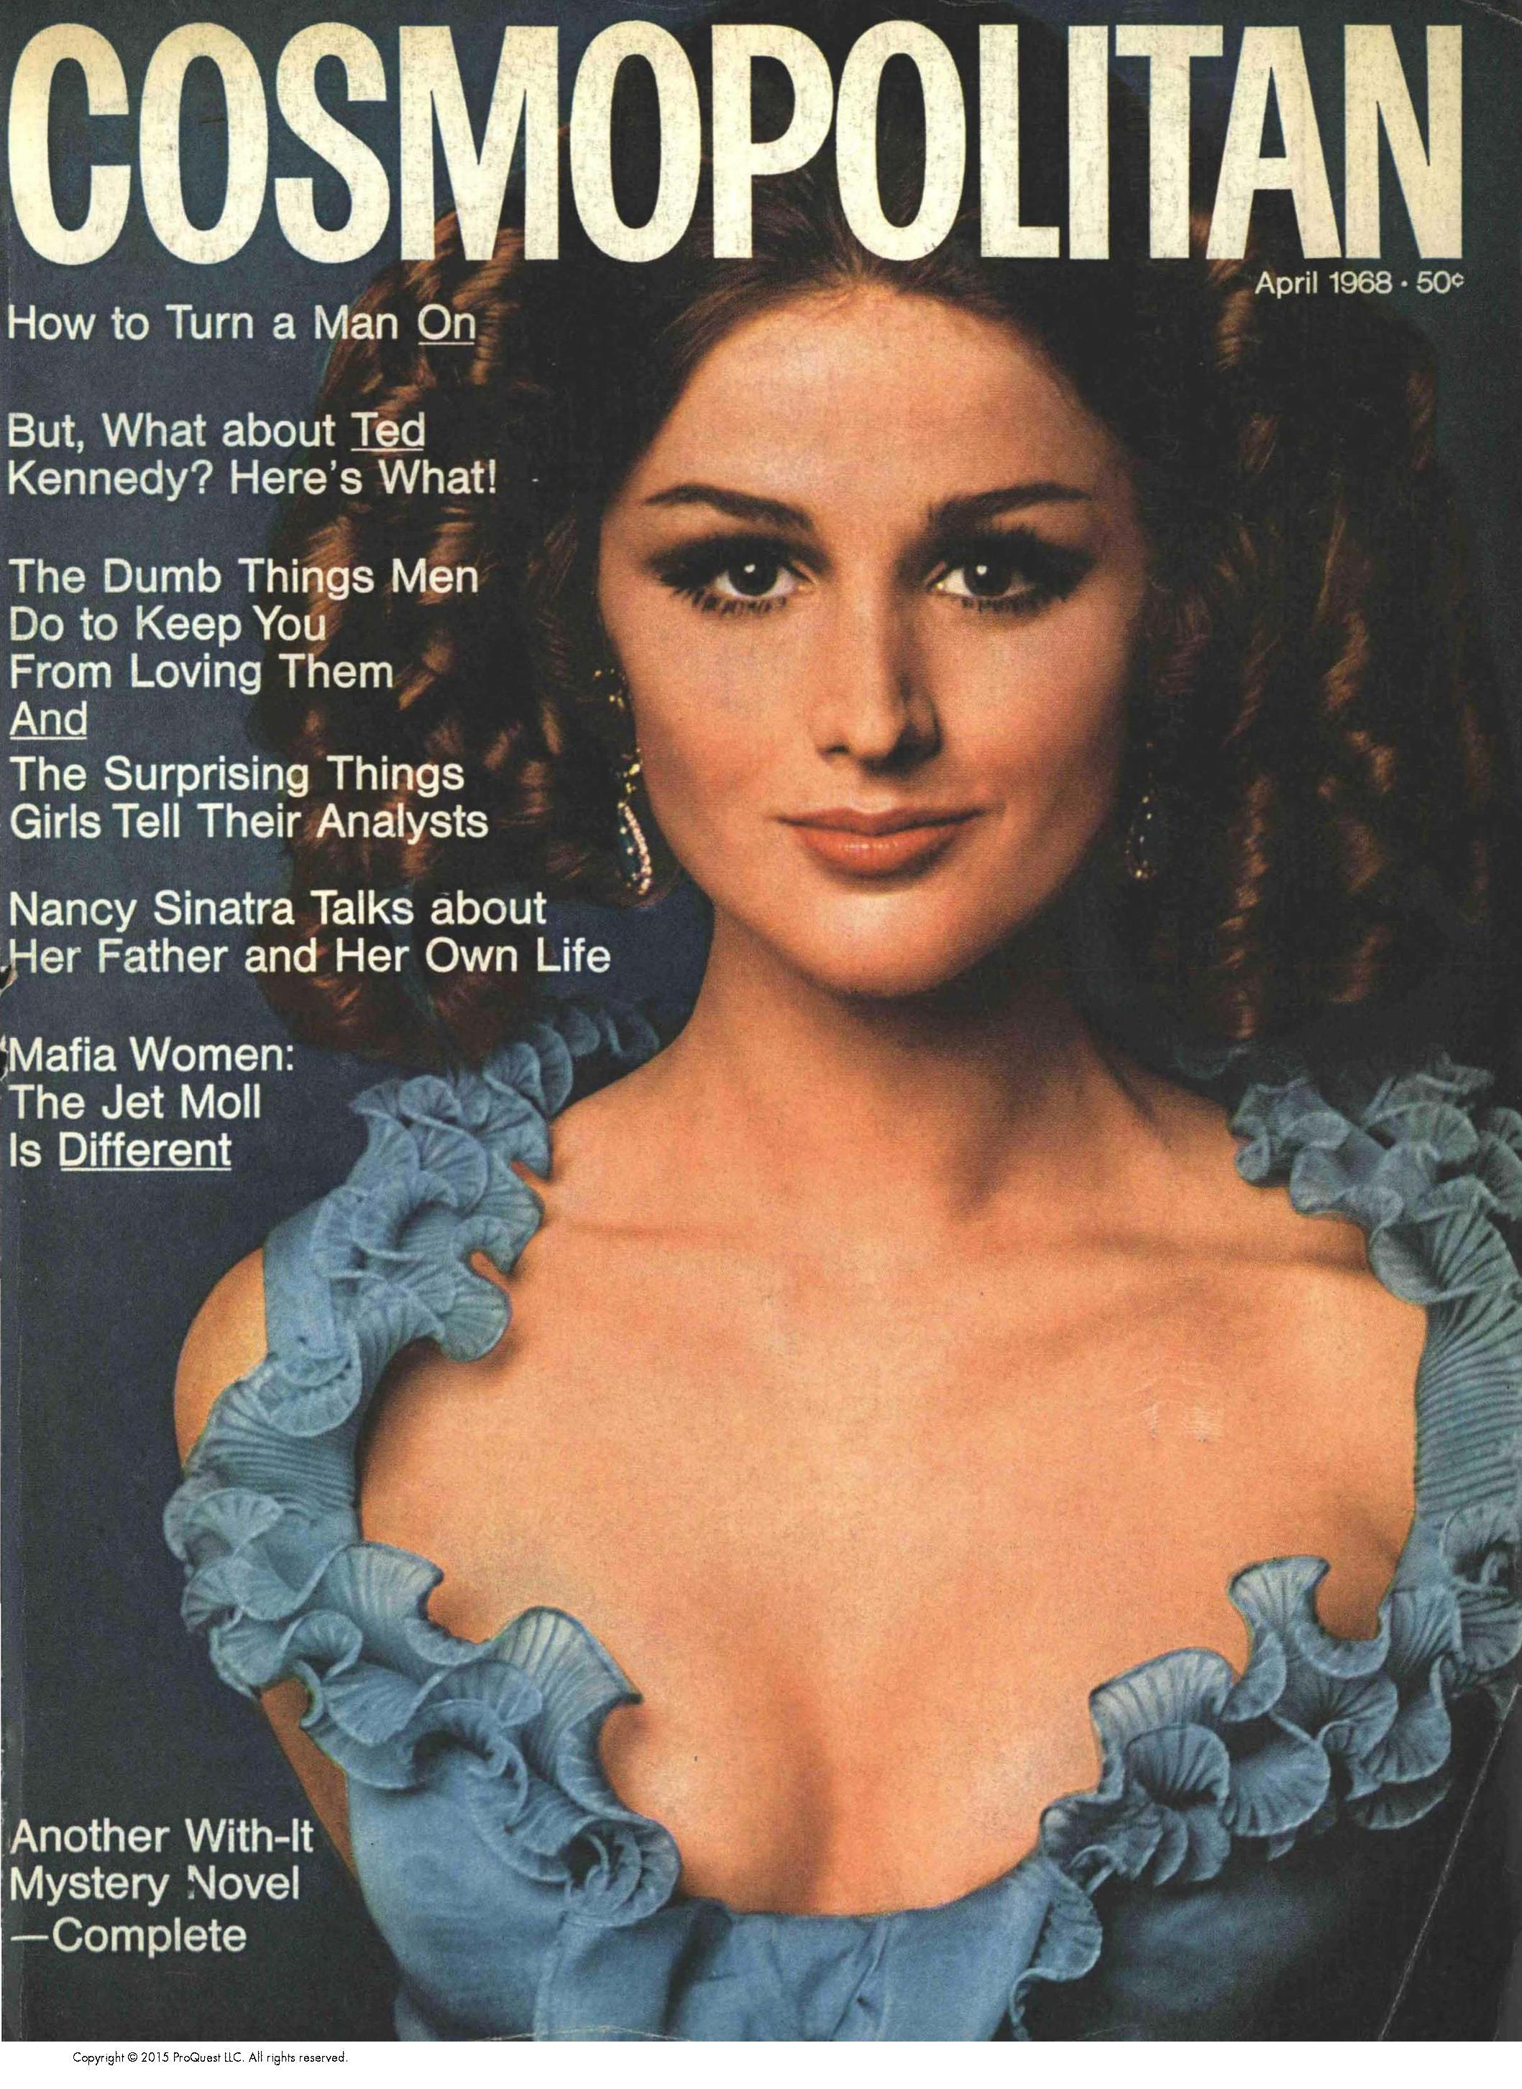
AVERAGE PIXEL IMAGES WITH NUMPY AND OPENCV
1960-1964
1962
1964
1965-1969
1966
1968
Notes:
Finally, I also did image analysis to further support my textual analysis. Using average pixel images I created a composite cover for each decade, and the 50s and 60s did not have a cohesive style, see the 1962 and 1964 images, besides the cosmo logo, But If I divided the composite into before and after 1965,

Slide 18
AVERAGE PIXEL IMAGES WITH NUMPY AND OPENCV
1960-1964
1962
1964
1965-1969
1966
1968
Notes:
I found that I could see a portrait start to appear, shifting to a single "cover girl," further supporting my findings that cosmo's content in the late 60s shifted to focus on the woman as an individual and her particular interests,

Slide 19
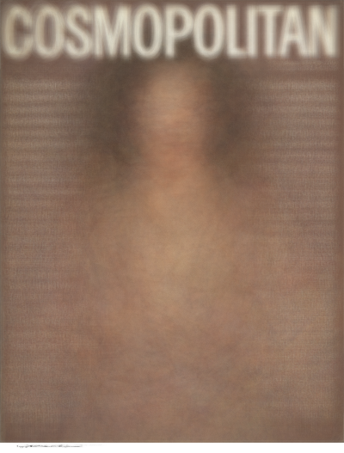
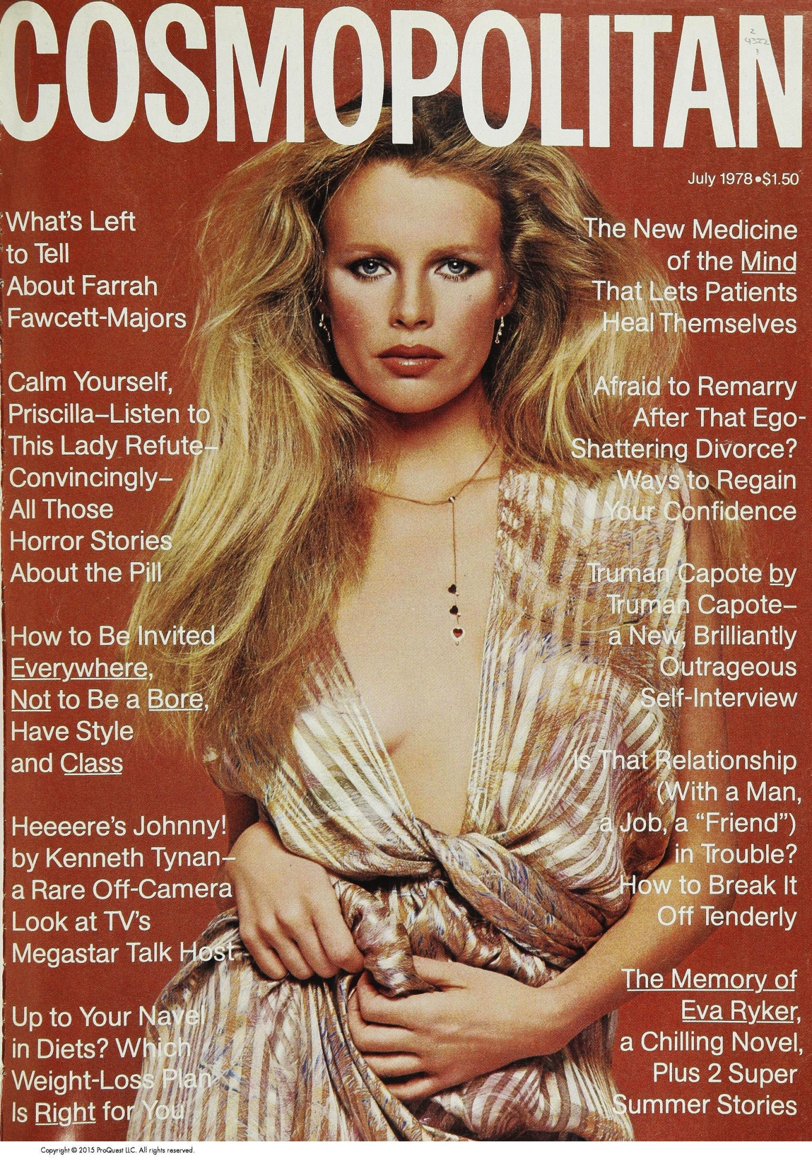
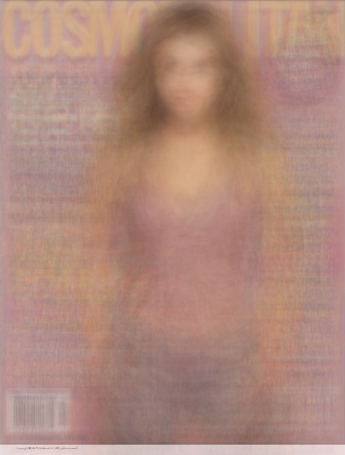
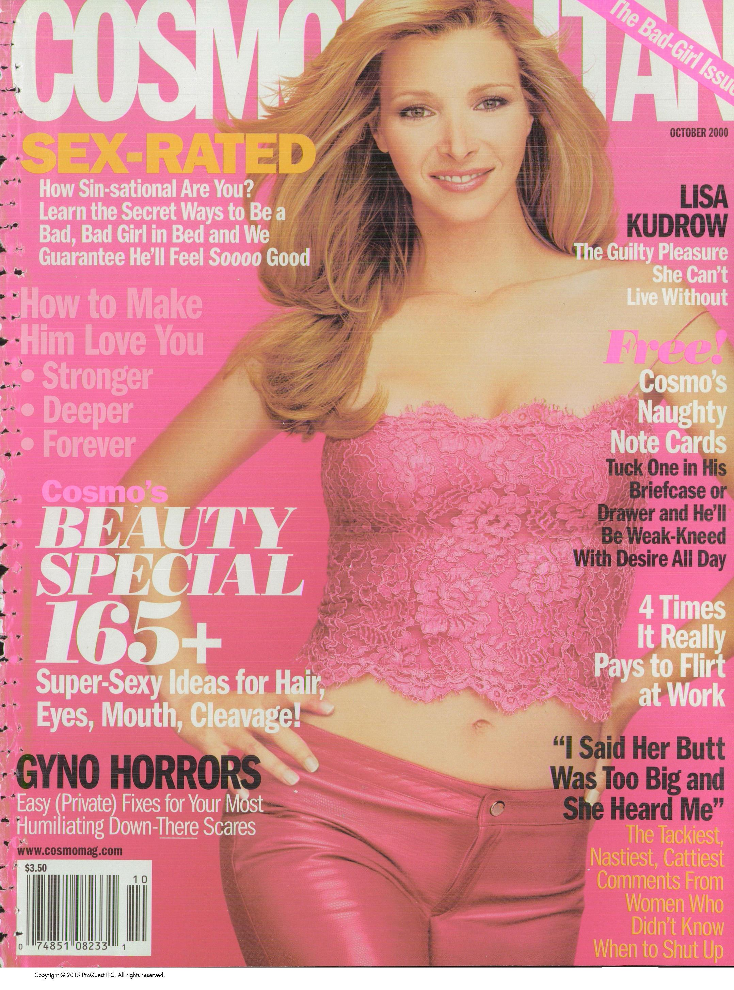
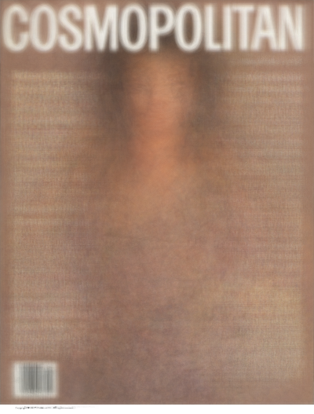
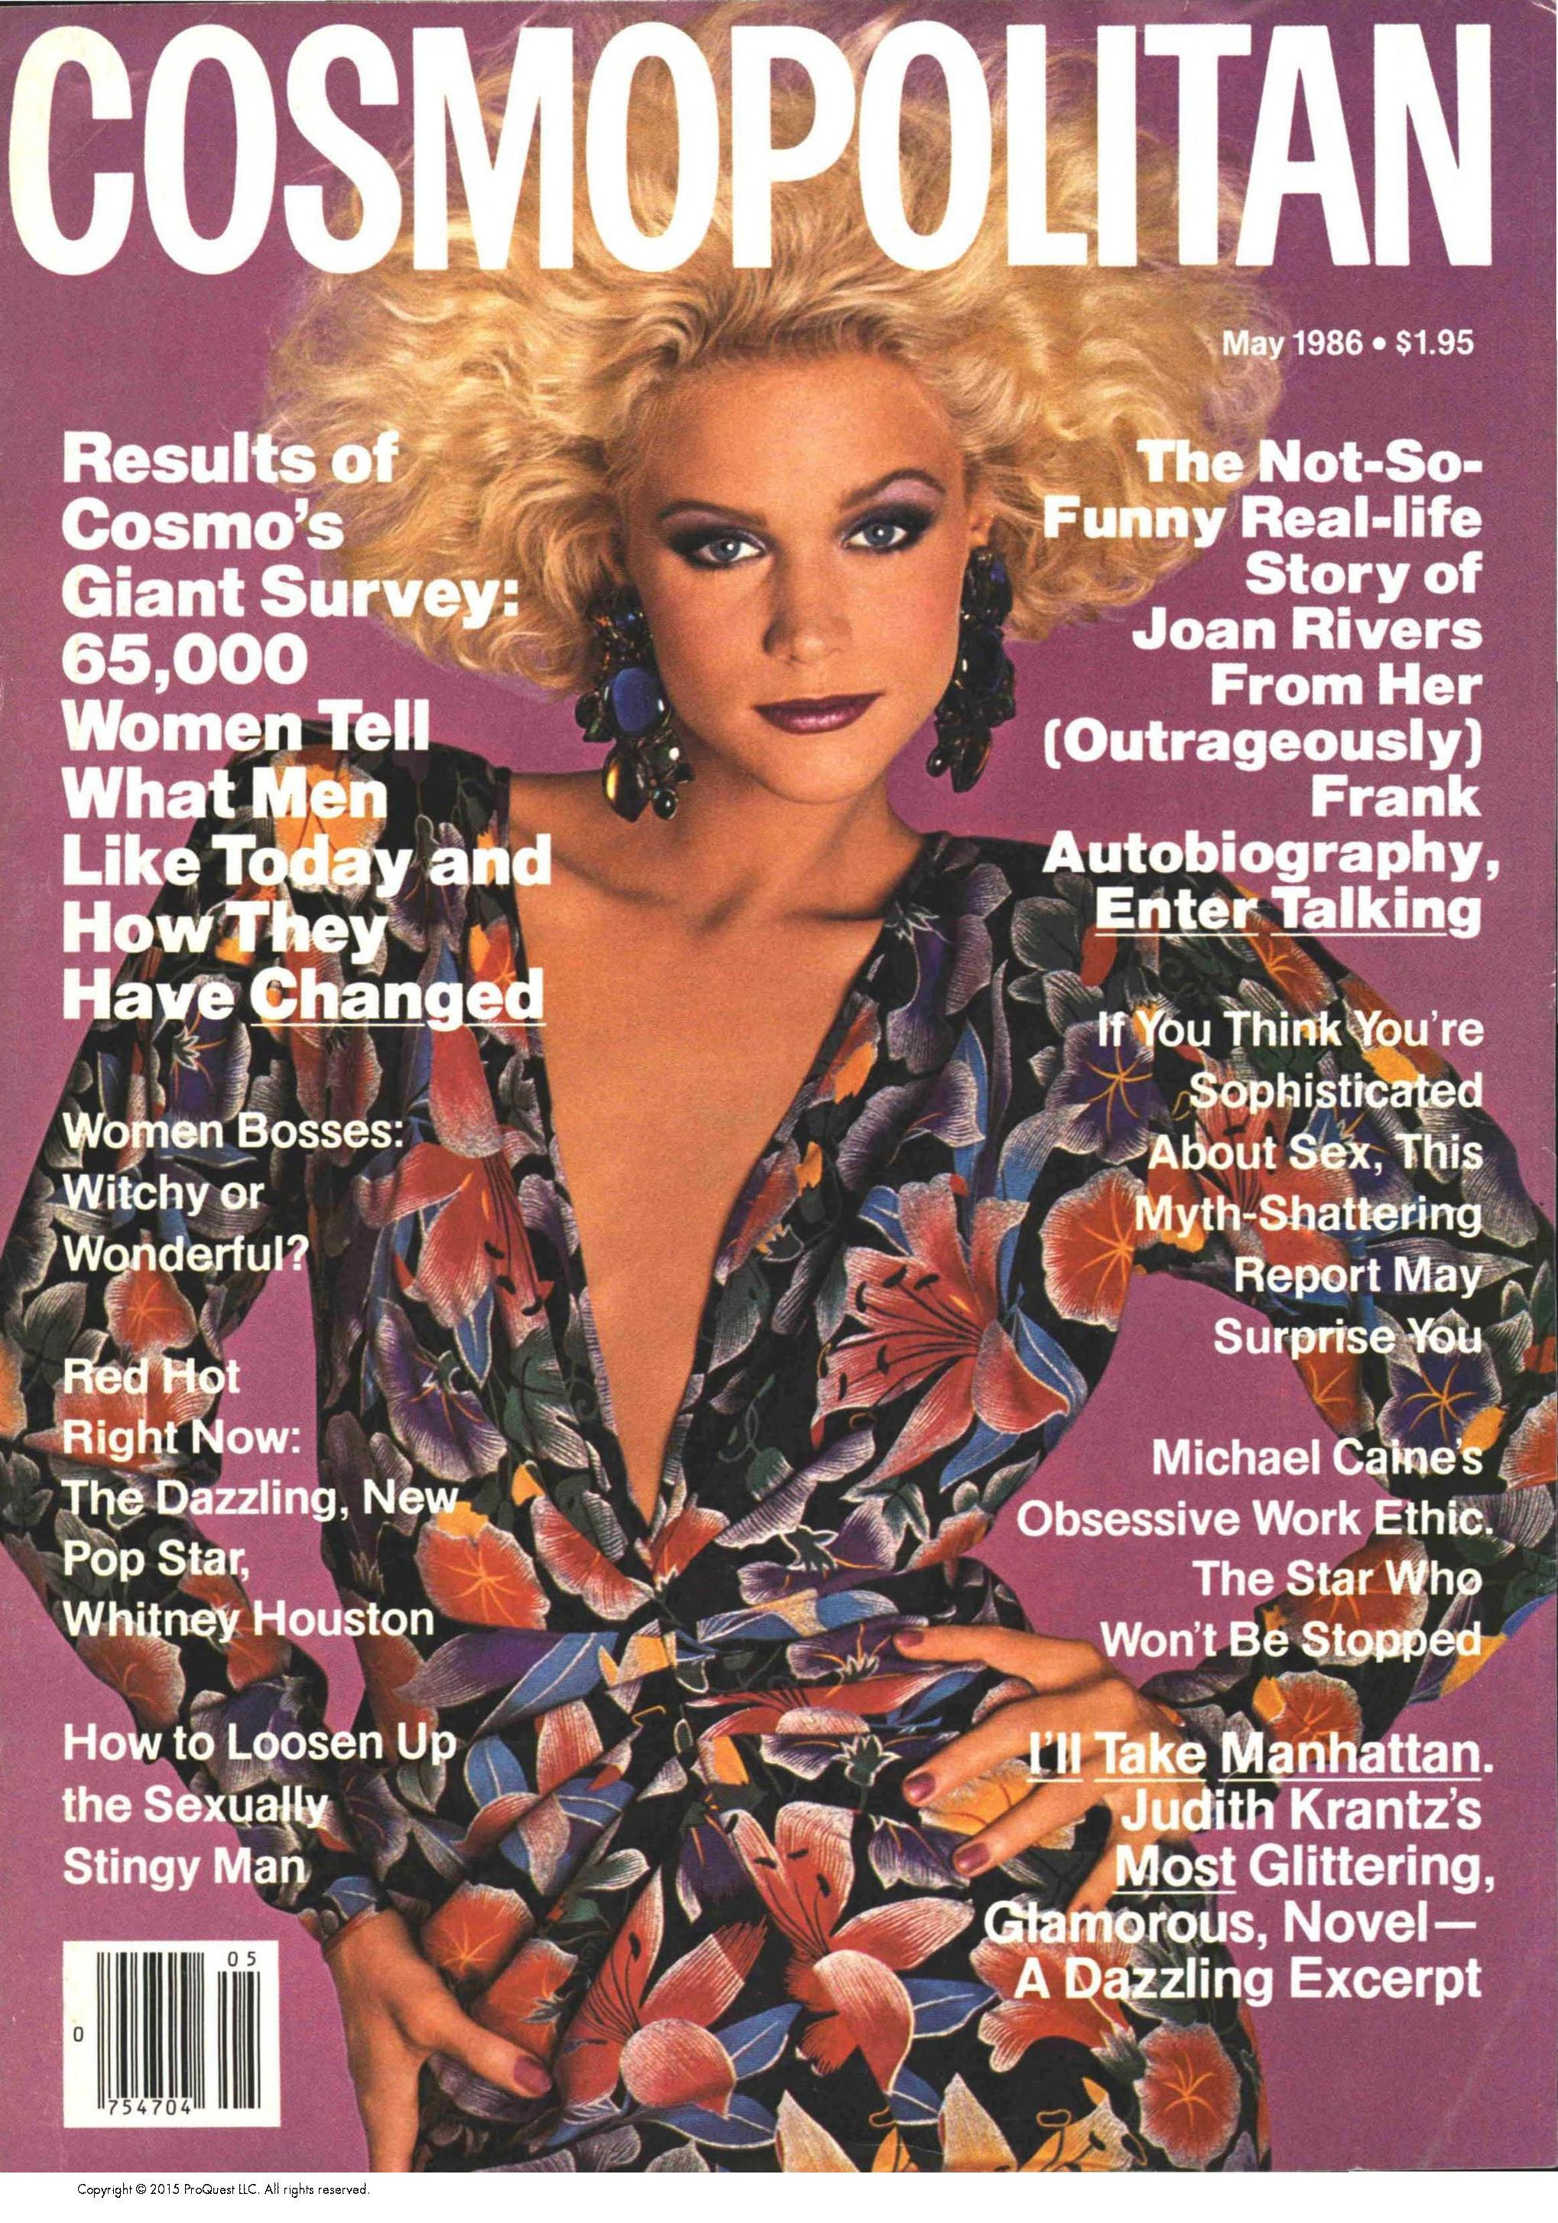
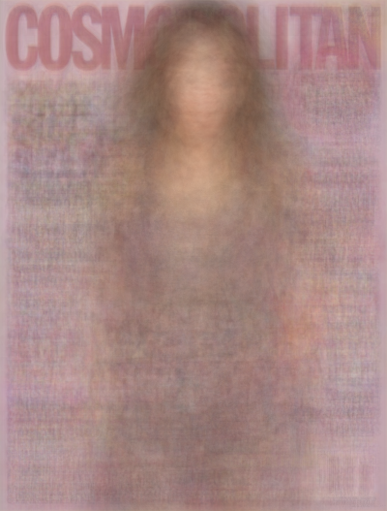
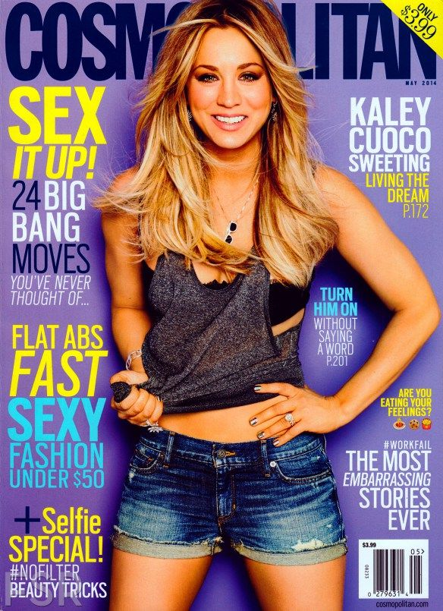
AVERAGE PIXEL IMAGES WITH NUMPY AND OPENCV
1970s
2000s
1980s
2010s
Notes:
Then starting in the 70s we see the standard cover consisting of a central woman usually white posing with 3/4 of her body shown.
With the more contemporary topic changes to more empowering language, I am interested to see how much longer this style exists, because to me it feels a bit more objectifying than empowering, and out of curiosity I looked at 2019s covers:

Slide 20
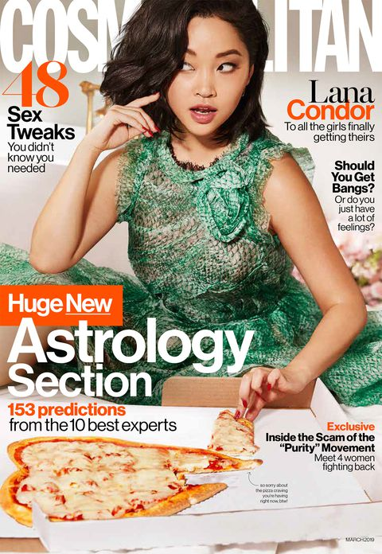
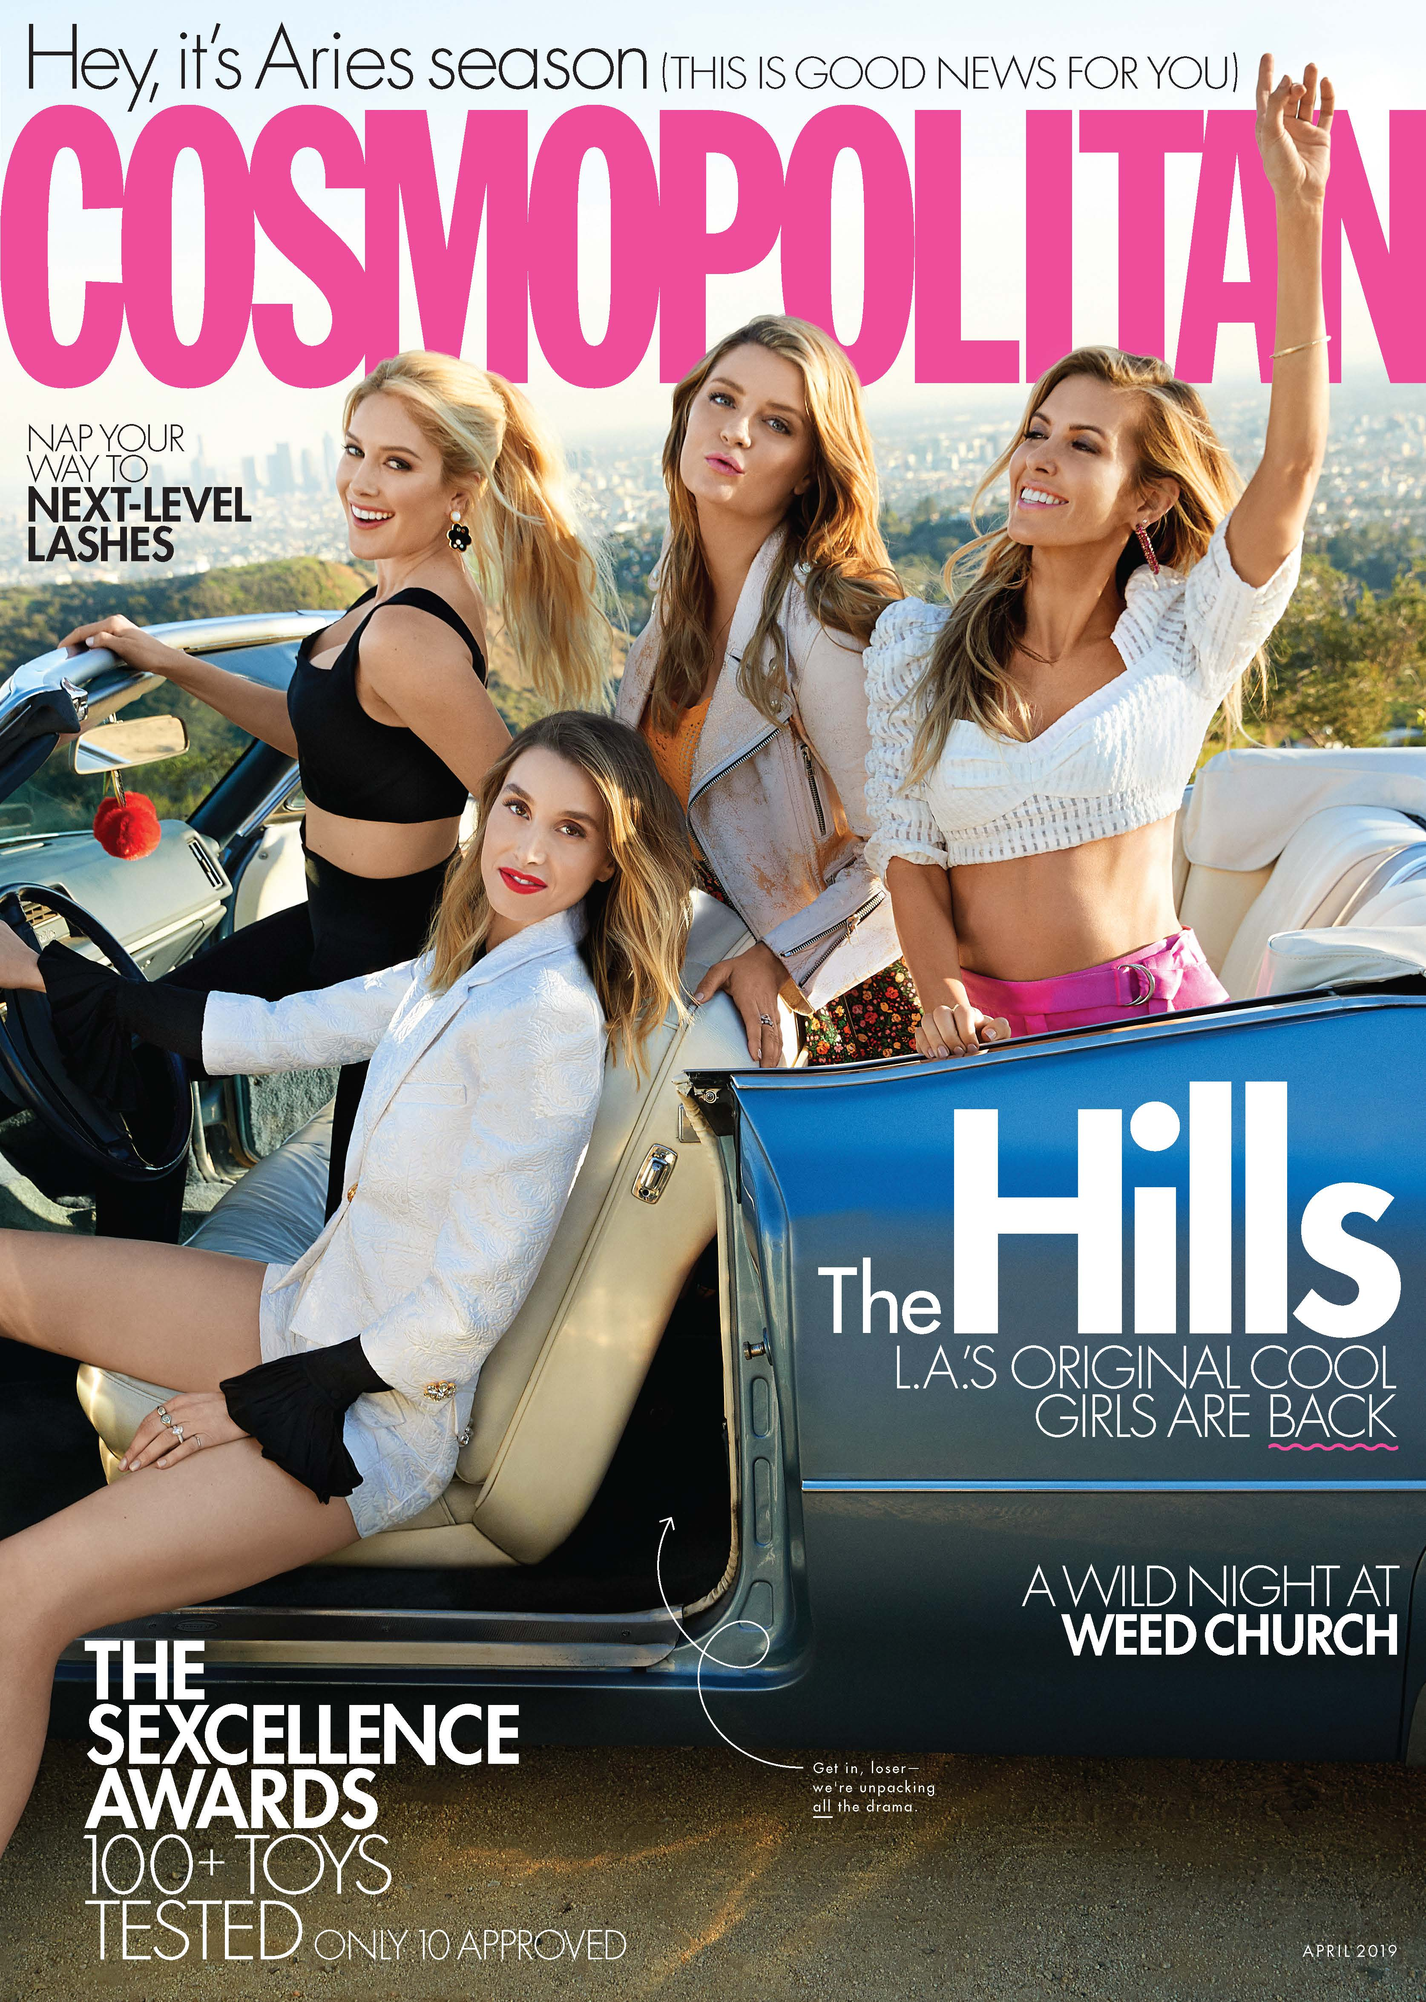
Notes:
And these march and april’s covers from this year. We have a pizza front and center, and the first cover with multiple people since the 60s, so it seems like the mold is starting to break down!

Slide 21
Conclusions
Shifts in editors at Cosmo create the largest content shifts
In 1965, a shift in focus occurred from content women might be interested in, to content that is about women as individuals
In the 2000s, we begin to see more words associated with “power”
Graphic shifts in cover images correspond to these topic shifts
Notes:
Conclusions: my main findings were that Text and graphic changes correlate with changes in leadership and we are continuing to see growth and changes societies acceptance and support of the autonomy and individuality of women in the material that is meant to attract and portray us.

Slide 22
THANK YOU
Nora May March 28, 2019
Metis Career Day

